Slide 1
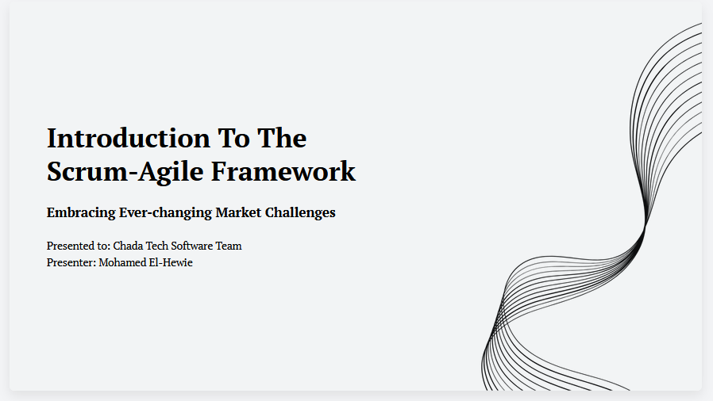

Slide 2
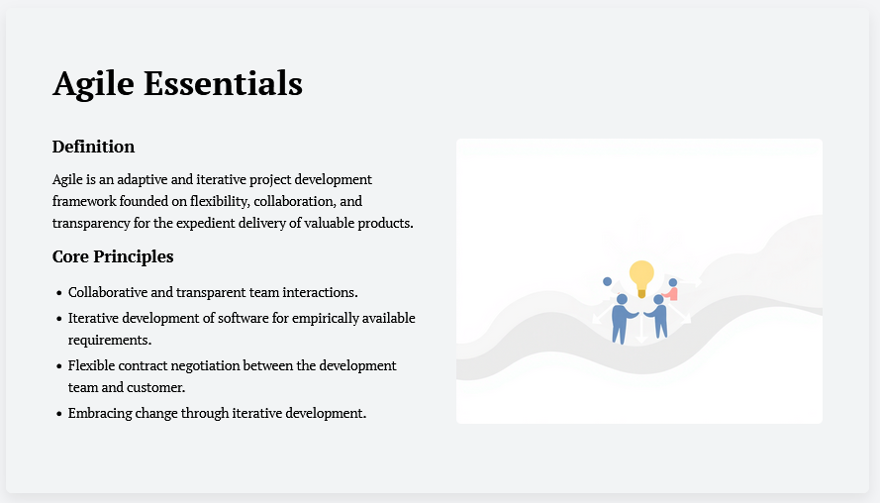

Slide 3
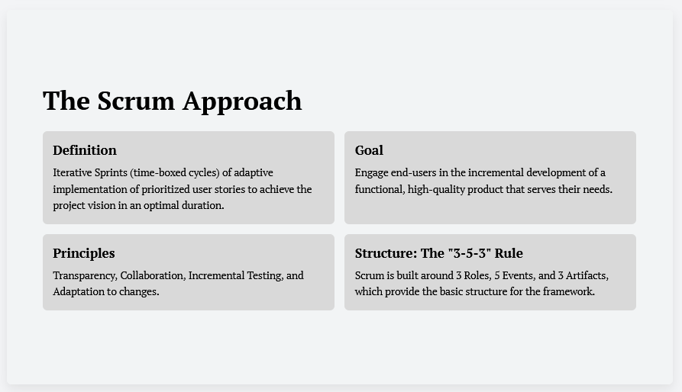

Slide 4
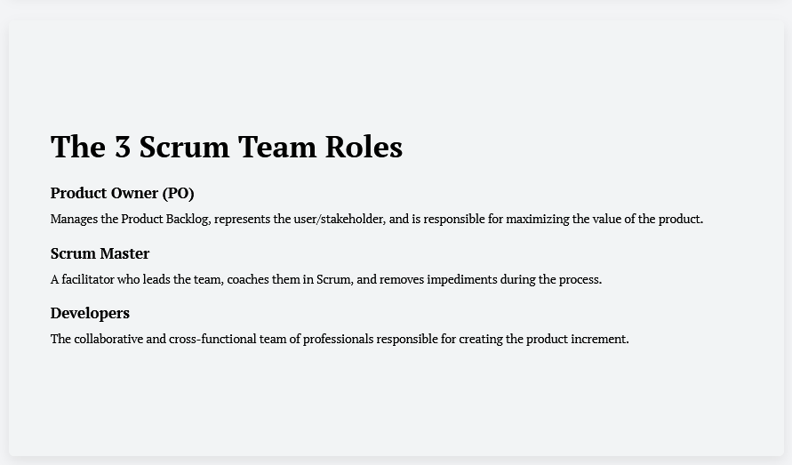

Slide 5
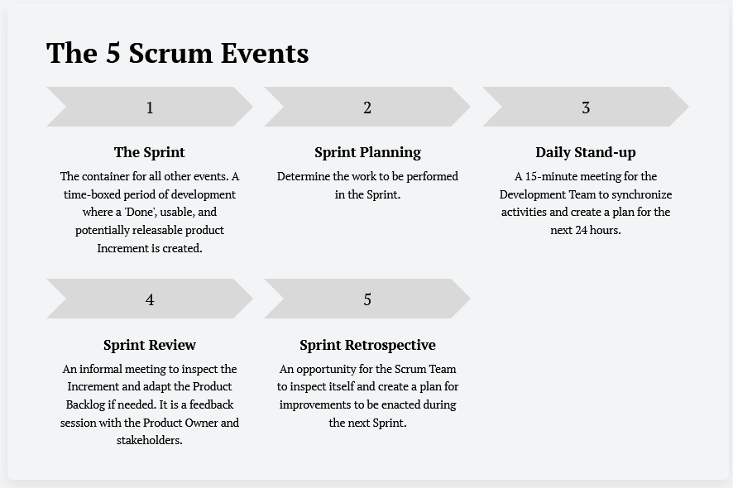

Slide 6
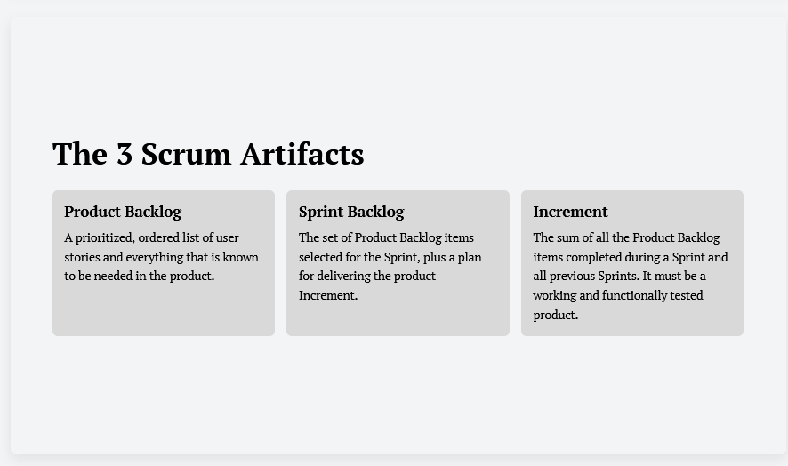

Slide 7
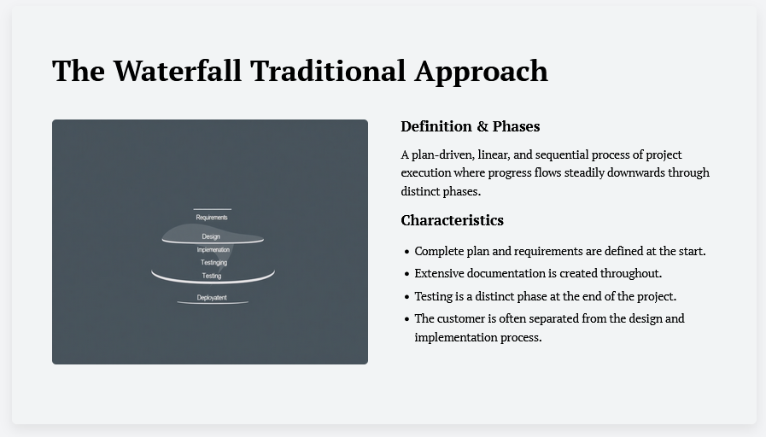

Slide 8
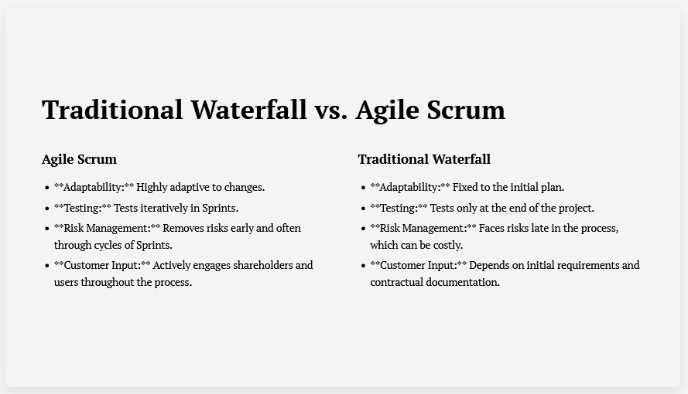

Slide 9
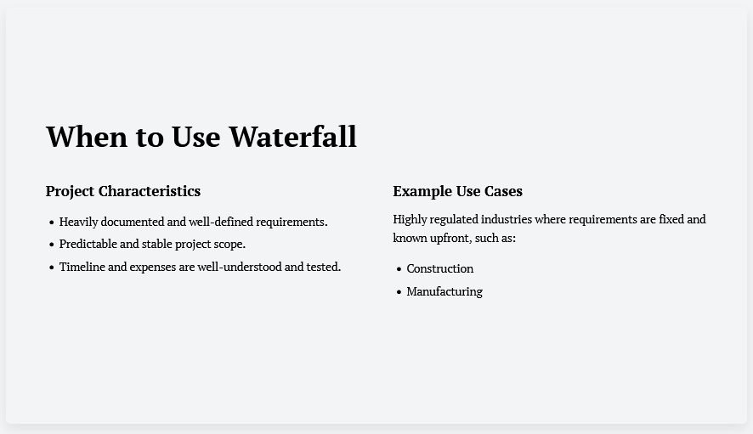

Slide 10
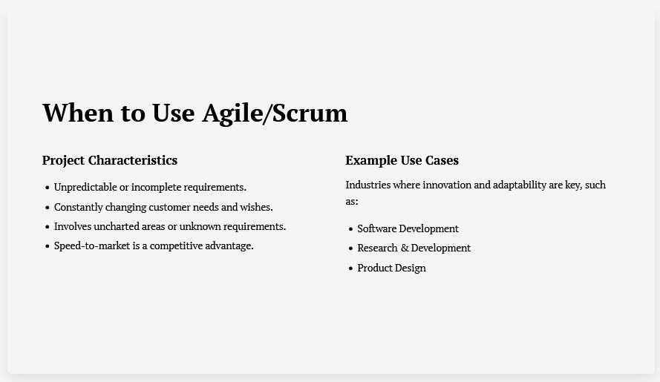

Slide 11
Slide 11: References
[1] The Complete Guide to Scrum Ceremonies, /MAR 16, 2026
https://www.wrike.com/scrum-guide/scrum-ceremonies/
[2] The Scrum Guide (2020): Ken Schwaber and Jeff Sutherland.
https://scrumguides.org/docs/scrumguide/v2020/2020-Scrum-Guide-US.pdf
[3] Leontine S. Osuagwu. (2023) "The Scrum Master Bible"
[4] Chandan Lal Patary. (2019). “The Scrum Master Guidebook: A Reference for Obtaining Mastery.”
[5] Scrum vs Waterfall: A Complete Detailed Comparison. By KnowledgeHut .
Feb 20, 2025
https://www.knowledgehut.com/blog/agile/waterfall-to-scrum

